Slide 1
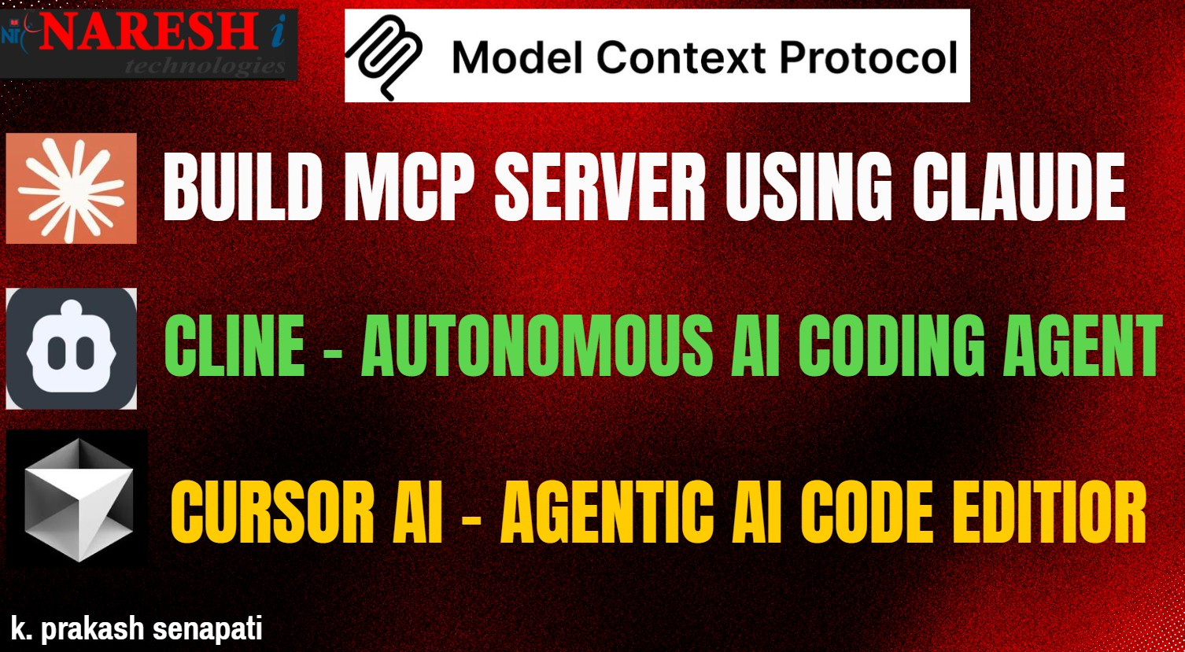

Slide 2
LLM ( Large Language Model)
🧠 LLM (Large Language Model)
Think of LLMs like brains that understand and generate human-like language.
Examples: GPT-4, Claude, Gemini, Mistral.
Trained on massive text data.
Can answer questions, generate content, write code, etc.
💬 What it does: “Tell me a joke” → Writes a funny one-liner.

Slide 3
AGENTIC AI
🤖 Agentic AI
Now imagine giving that brain goals, tools, and memory — it becomes an agent that can act on its own.
Agentic AI = LLM + memory + reasoning + tools + autonomy.
Can perform multi-step tasks on its own.
Example: “Plan a weekend trip and book tickets” → Agent books, compares prices, checks calendar.
💡 What it does: Not just answers, but acts intelligently over time.

Slide 4

MCP (MODEL CONTEX PROTOCOL
It’s an emerging open-source framework developed by Anthropic to improve how Large Language Models (LLMs) like Claude, ChatGPT, or Gemini interact with
tools,
data,
memory,
Users
M → Model: This refers to any AI model you’re using (Claude, ChatGPT, etc.) C → Context: The useful information the model needs — like documents, past chats, or user preferences — to give better answers. P → Protocol: A set of rules that tells the AI how to use this context and interact with apps, tools, and workflows.

Slide 5
MCP (Model Context Protocol)
MCP is like the wiring system that connects the brain (LLM) with memory, tools, and other systems.
M = Model (LLM)
C = Context (chat history, files, tools)
P = Protocol (rules for how to use context and interact)
💼 What it does: Enables LLMs to read memory, use tools, and follow structured steps (like APIs or IDE plugins).

Slide 6
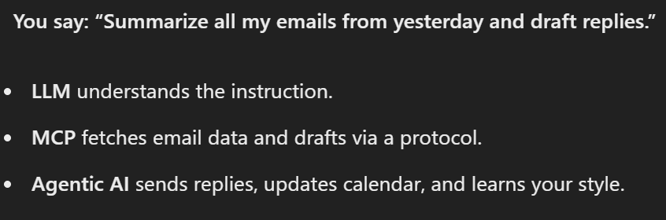
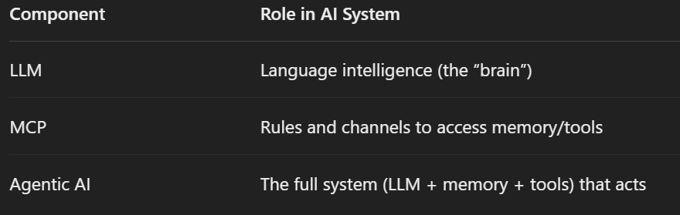

Slide 7

MCP DOCUMENTATION
https://modelcontextprotocol.io/introduction
https://github.com/modelcontextprotocol

Slide 8
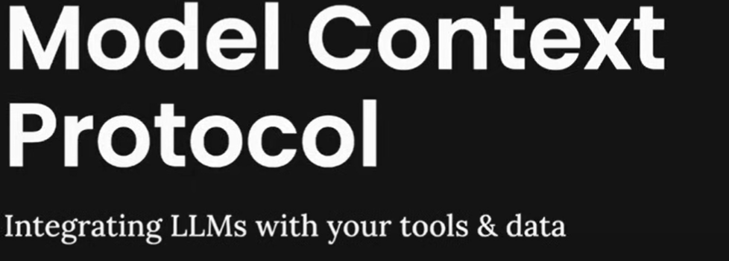
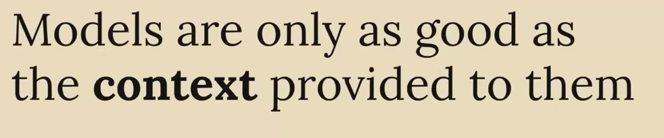
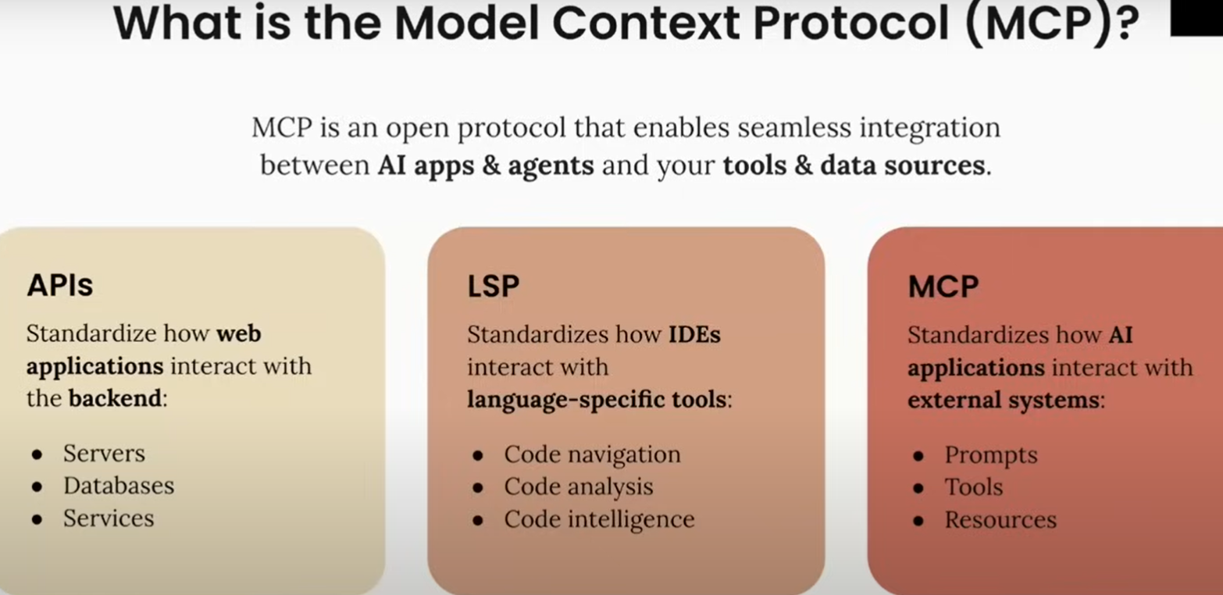

Slide 9
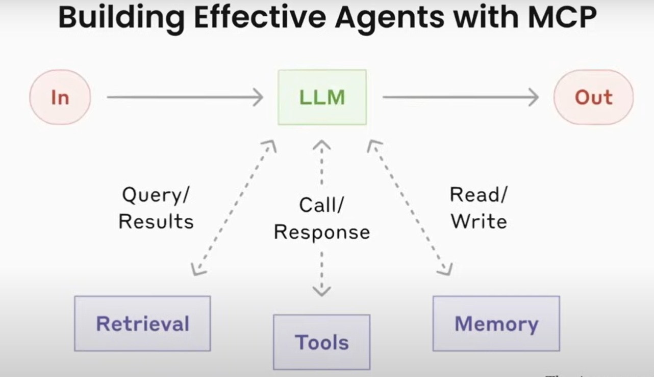

Slide 10
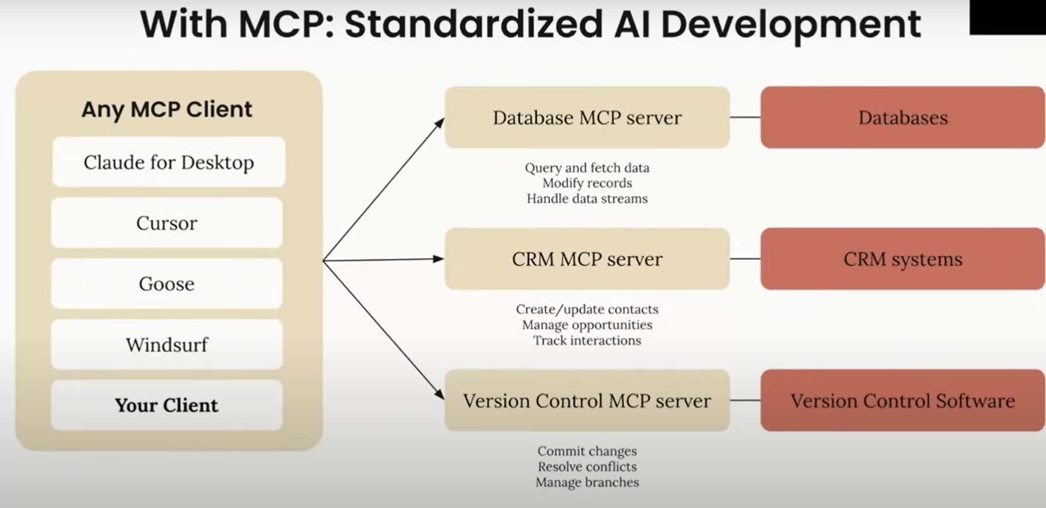

Slide 11
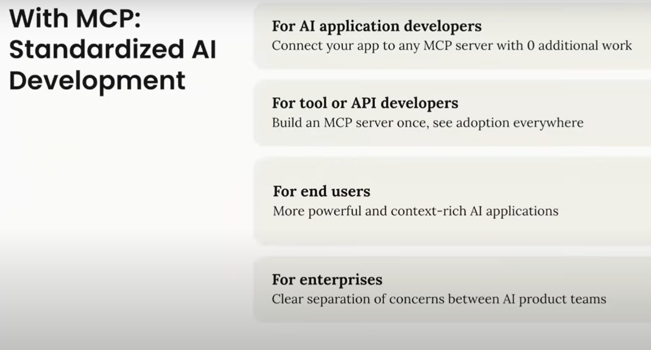

Slide 12
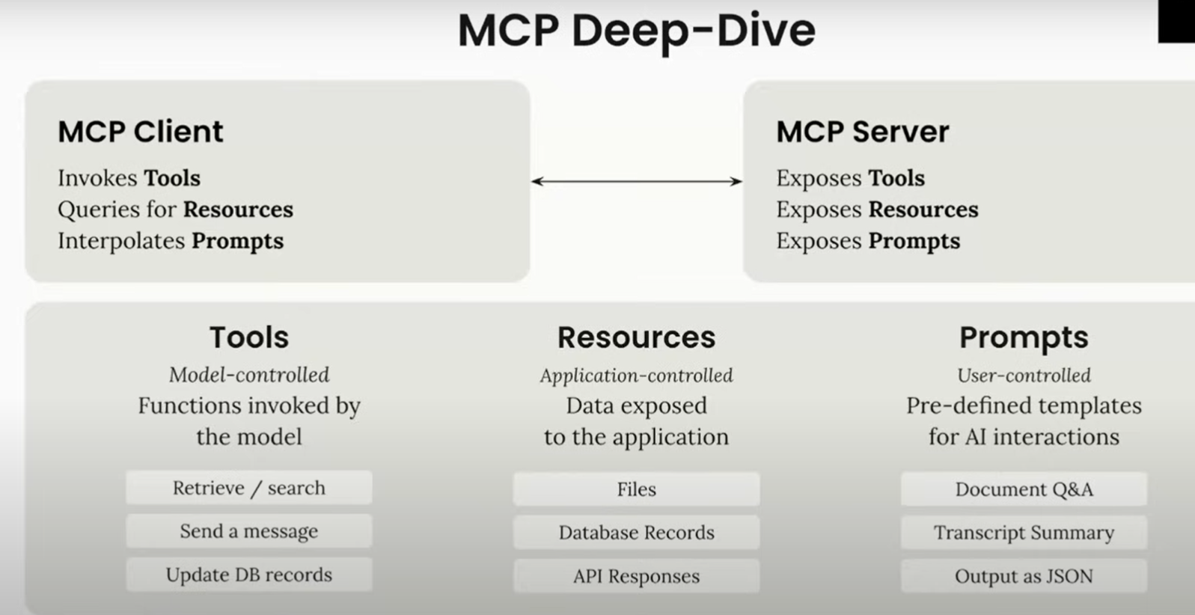

Slide 13
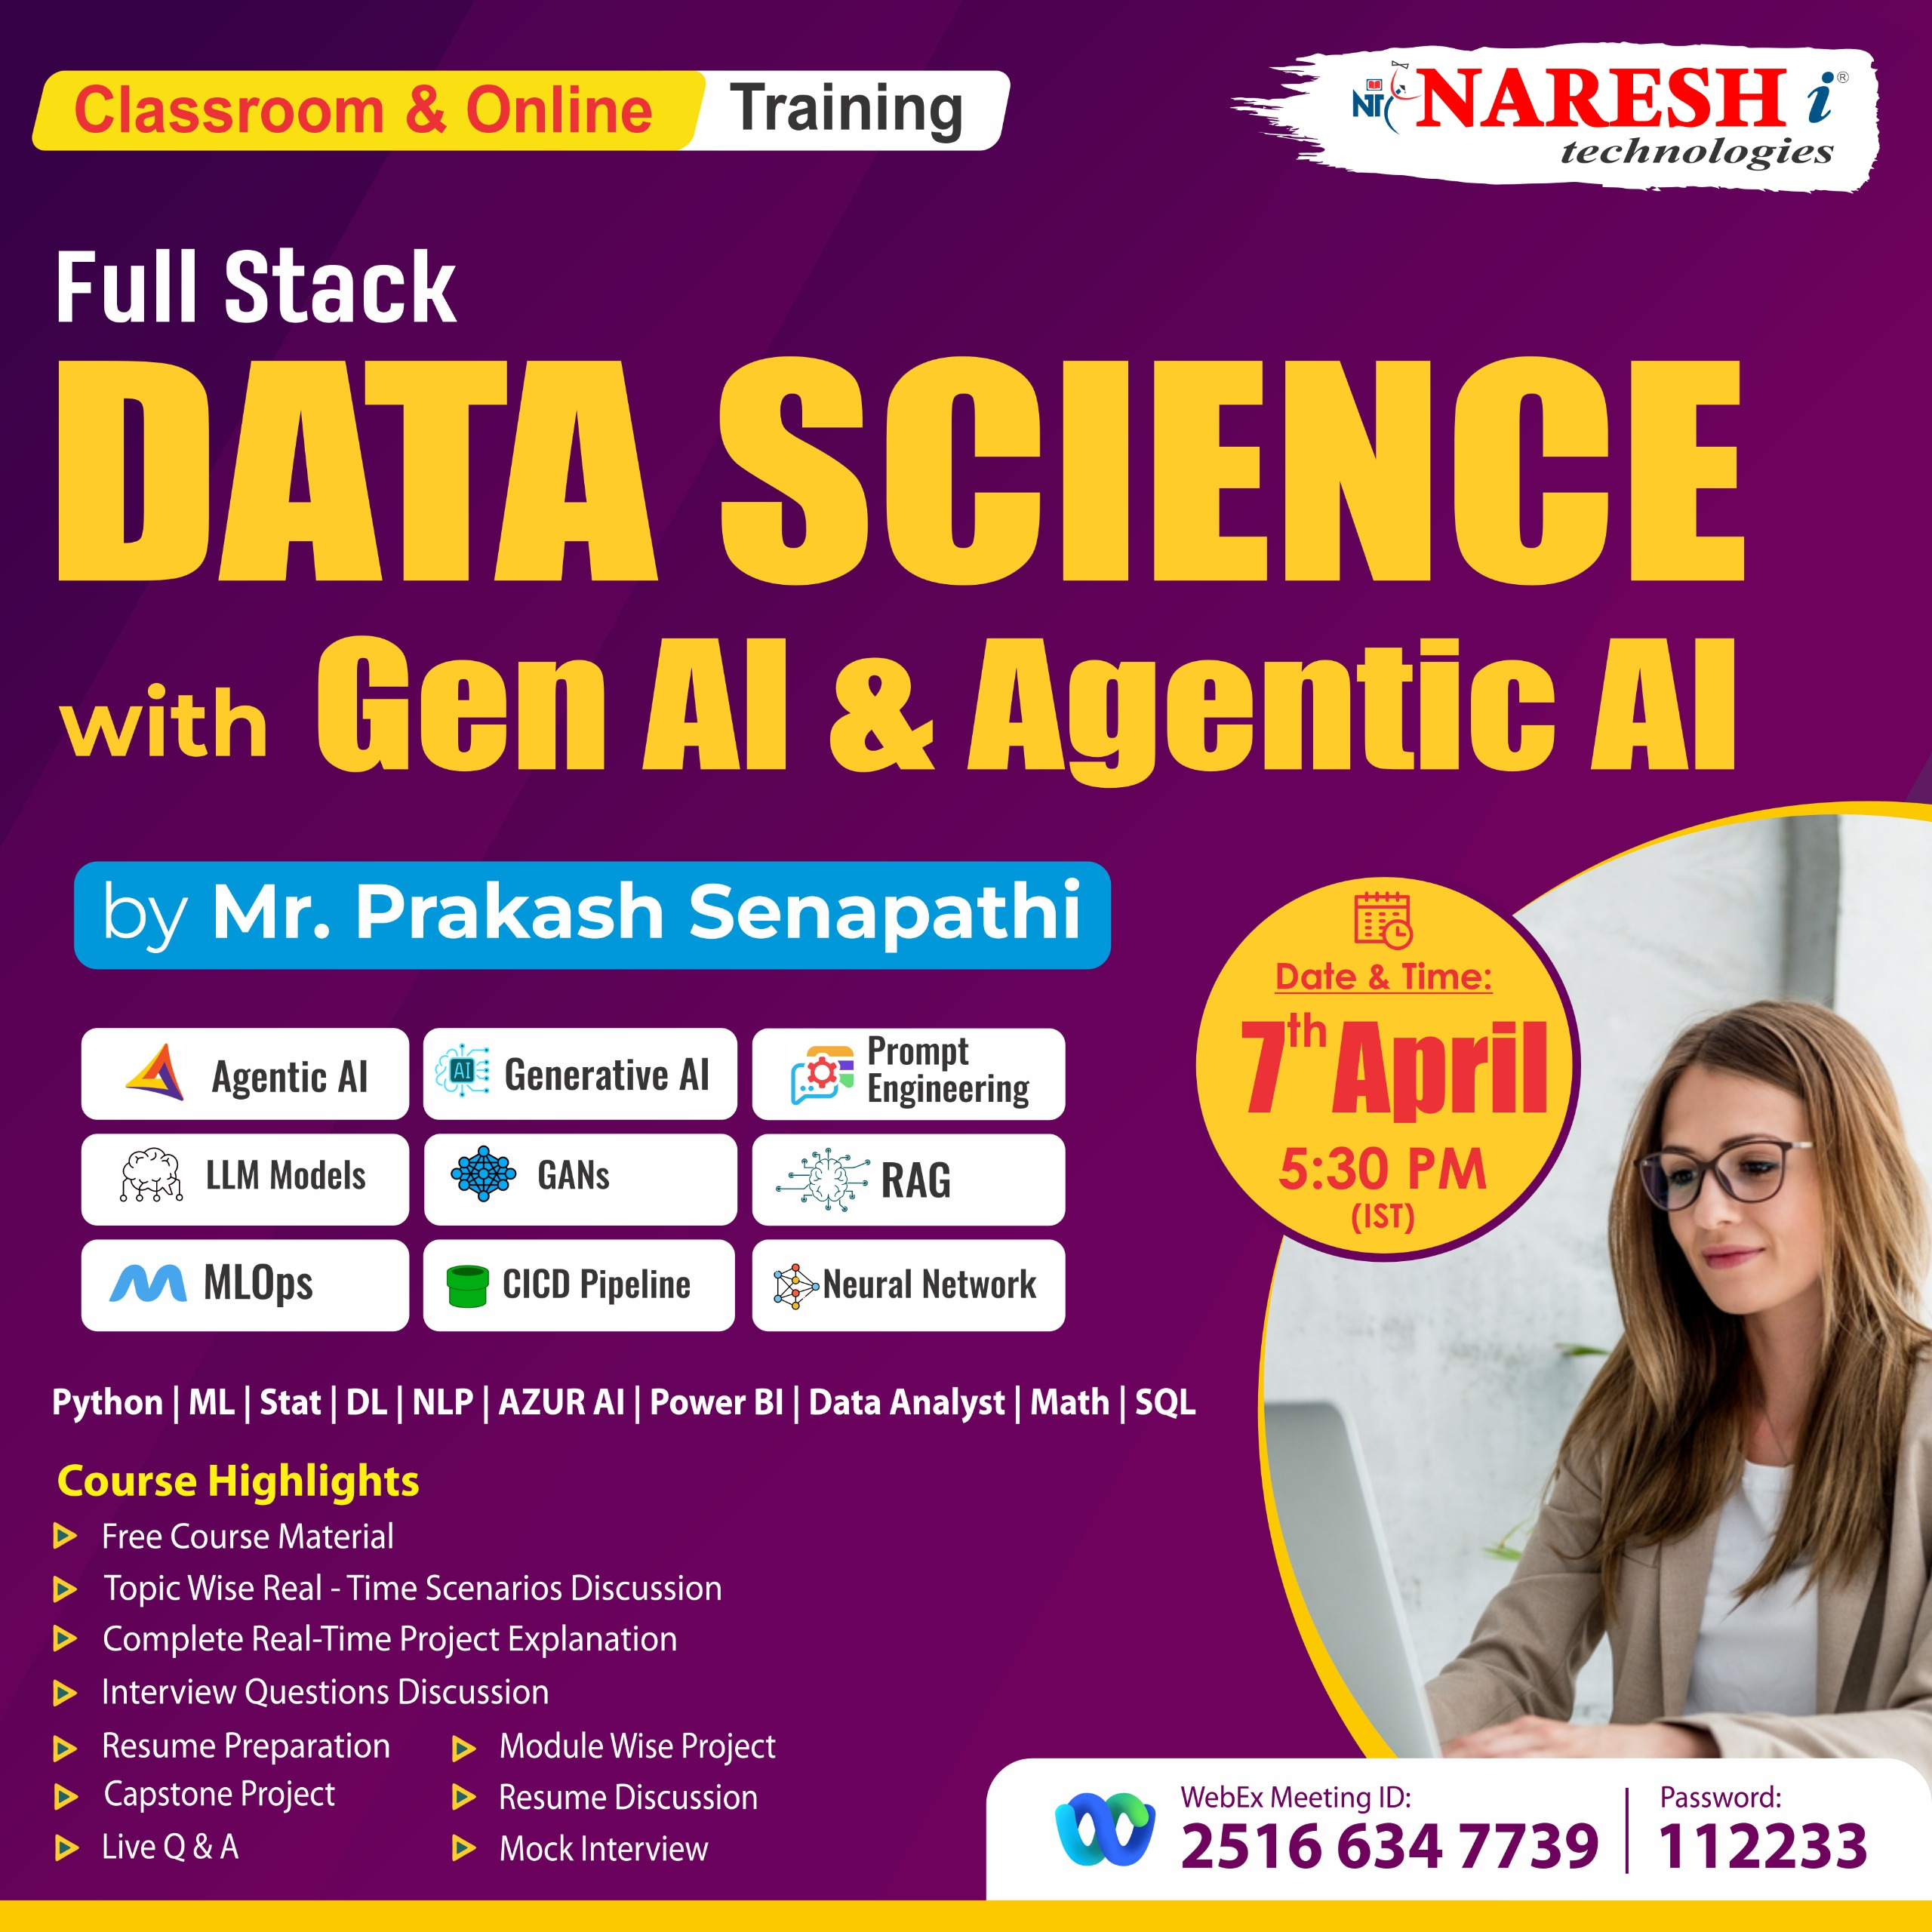

FSDS with Generative-AI & Agentic AI Starting Dt : 7th April @ 5:30pm Duration: Apr-Aug (6 month)
Joining URL:
https://web.webex.com/join-meeting
Meeting Id: 2516 634 7739
Password: 112233

Slide 14
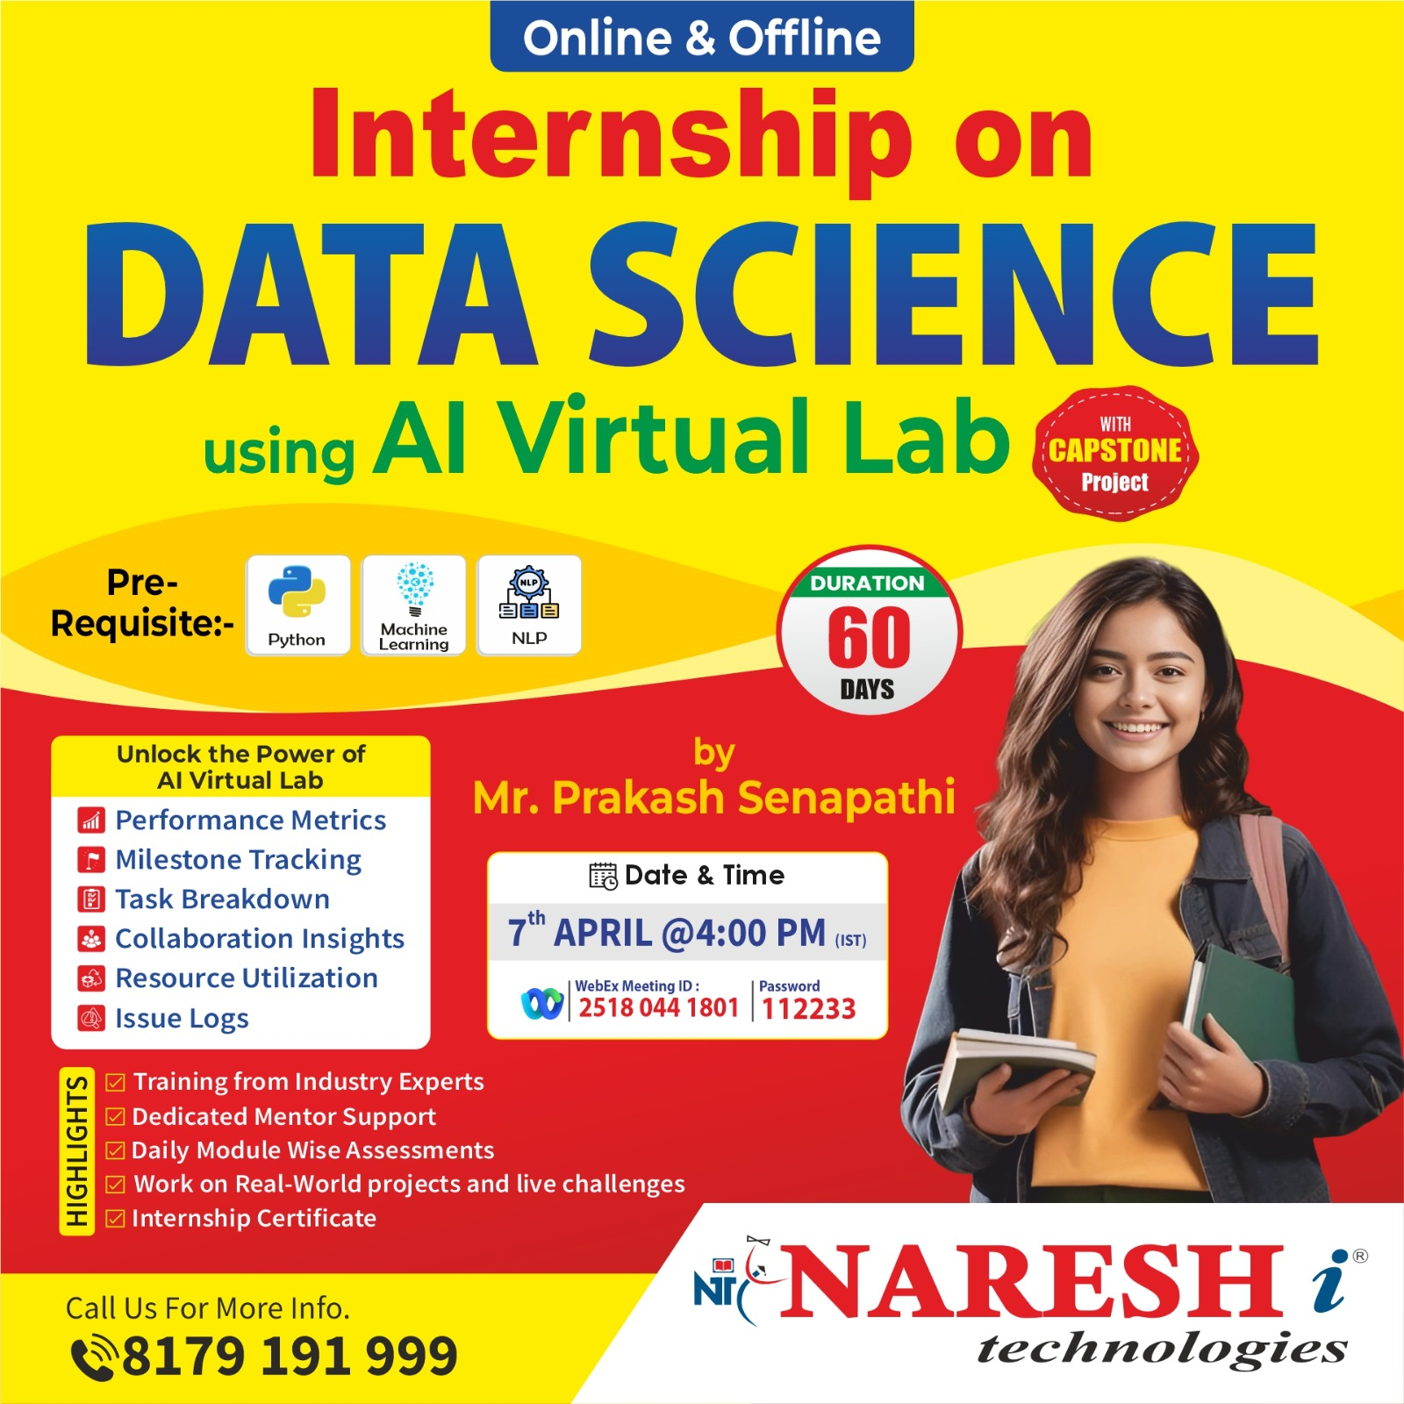
Internship Training + Placement Training Starting Dt : 7th April @ 4:00pm Duration: Apr - May (2 month)
Joining URL:
https://web.webex.com/join-meeting
Meeting Id: 2516 634 7739
Password: 112233

Slide 15
Previous Workshop Title
1- Resume Building Bootcamp for Data Analytics, BA, Data Science & GEN AI Roles ➔
playlist?list=PLVlQHNRLflP-SaPff3325gkISMHEznEix
2- Agenitic AI ➔ playlist?list=PLVlQHNRLflP8Pt3wVlRWRaXZXi79cIwSq
3- Data Analytics & Business Analytics ➔
playlist?list=PLVlQHNRLflP-BgYmMlM8YQpvQM2J99HE0
4- Generative AI ➔ playlist?list=PLVlQHNRLflP81c99eg7UhkVZxwPvhTddM
5- Python for Data science ➔ playlist?list=PLVlQHNRLflP9GN5rc8sBWnrV53DWAzfdn
6- AZUR AI (Cognitive Services) ➔playlist?list=PLVlQHNRLflP8JthpjvJFaofUkJS1A7qa1
7- MCP ➔ www.youtube.com/watch?v=6Ll5uB8VQto

Slide 16
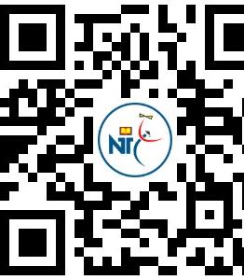
Follow this link to join my WhatsApp community ➔ Full Stack DATA SCIENCE with GEN AI & Agentic AI ➔ https://chat.whatsapp.com/Kkax9Vm3zu2JVO0cpPrMZS
Q & A

